Slide 1
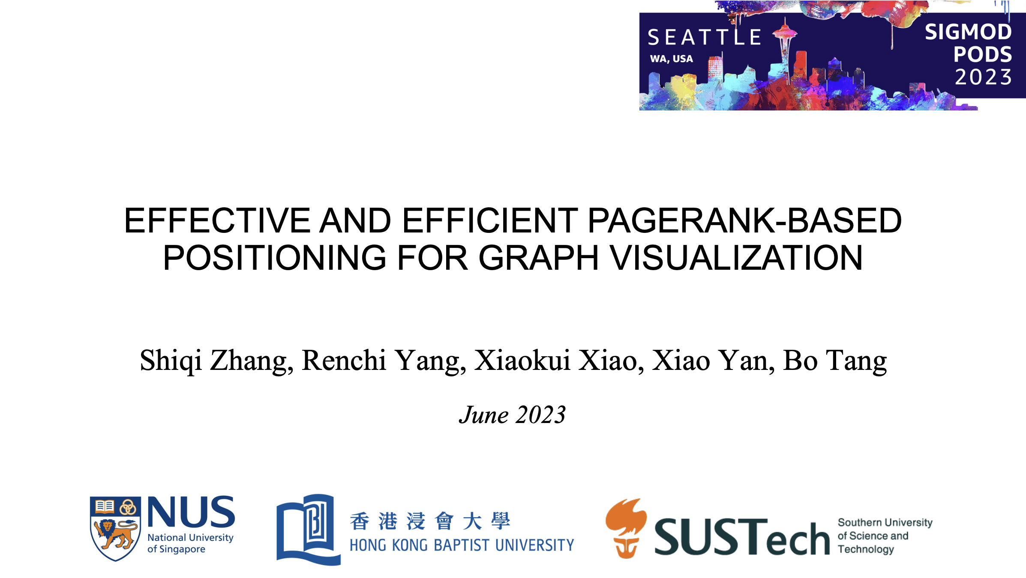
Notes:
Hi everyone, Today I would like to share a paper from NUS called ‘Effective and Efficient PageRank-based Positioning for Graph Visualization’

Slide 2
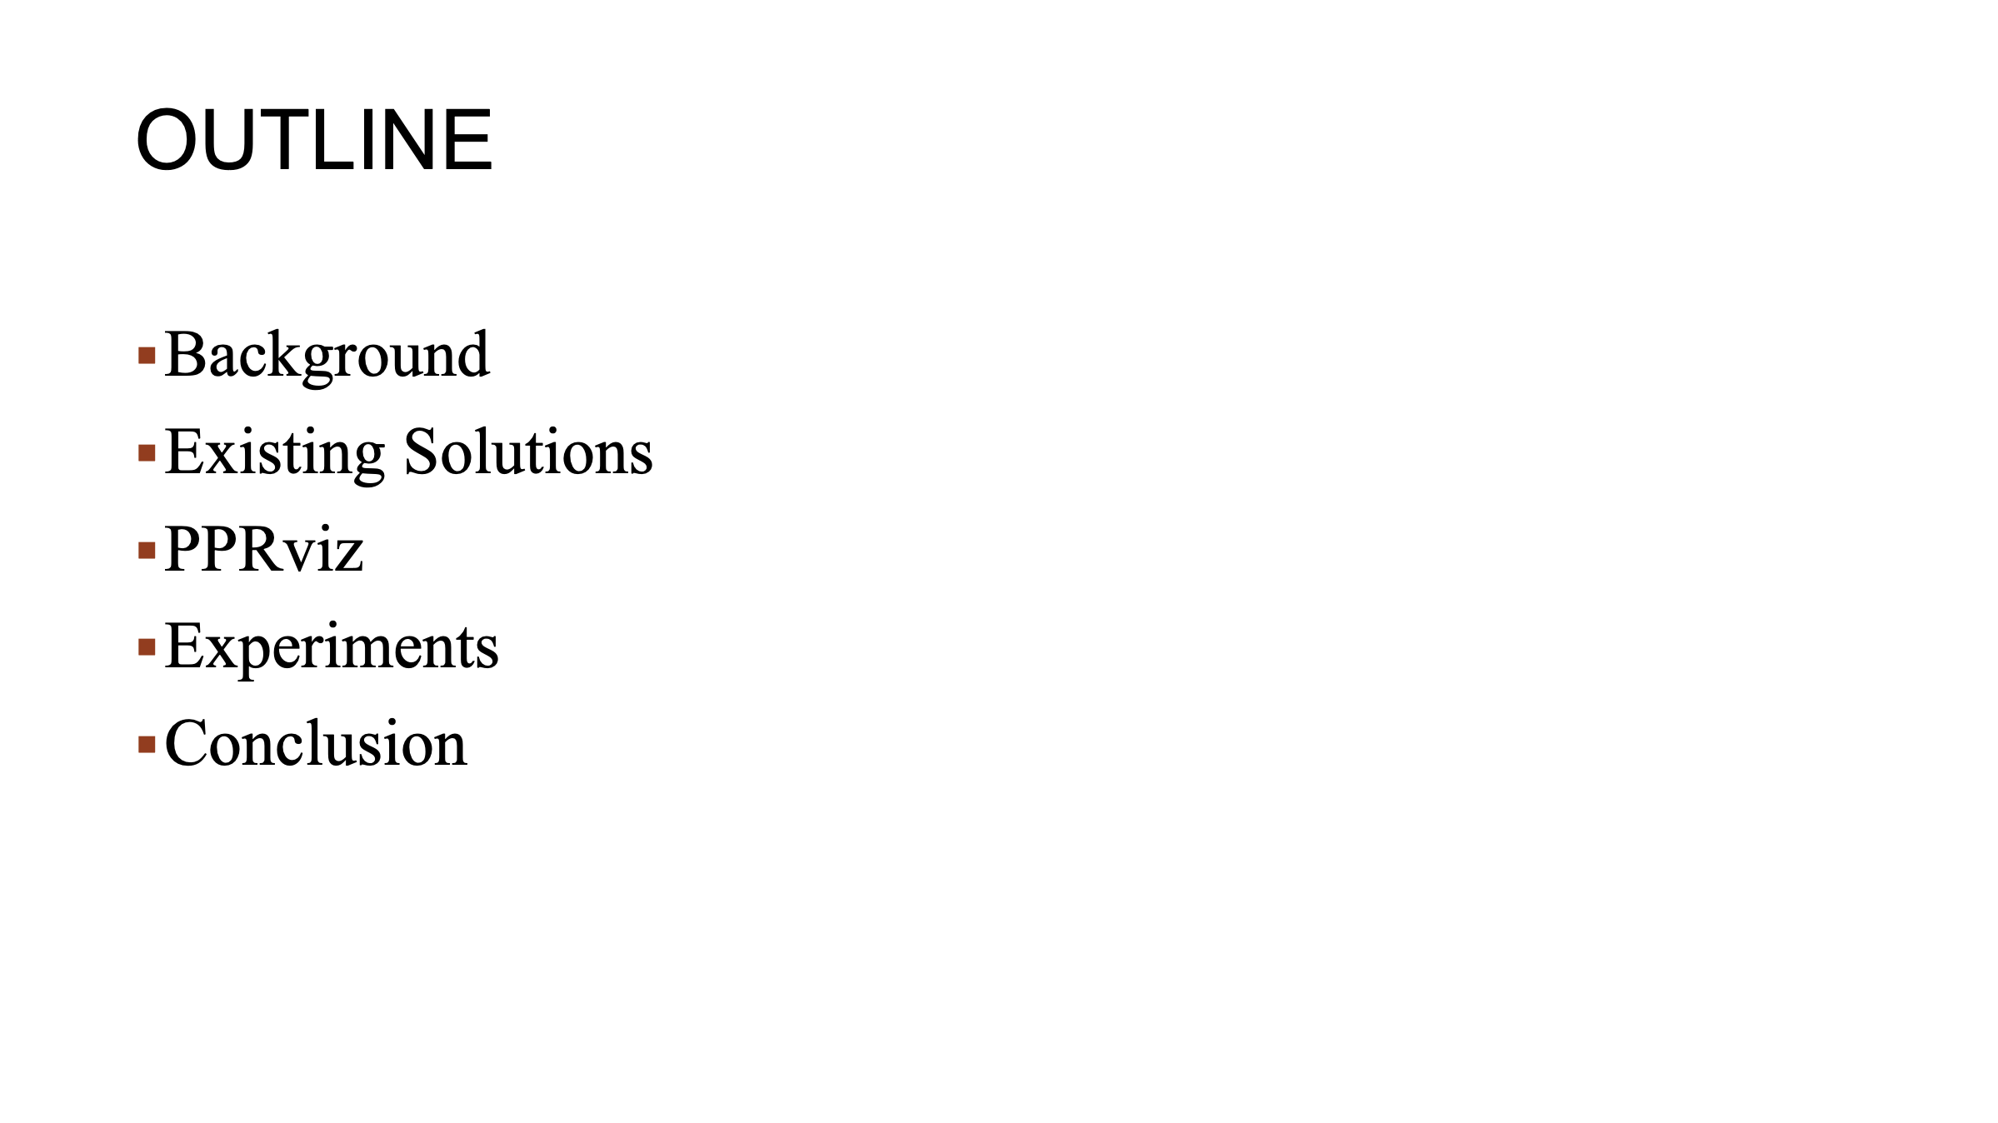
Notes:
Here is the outline for today's presentation. First, I will review the background and relative works of graph visualization. Then I will introduce the proposed visulization solution called PPRviz. Finally, I will share some interesting experiment results and the conclusion.

Slide 3
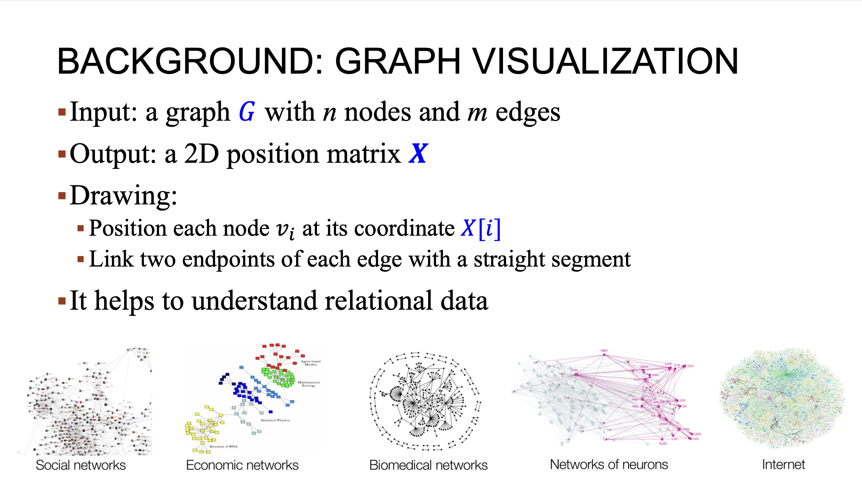
Notes:
Graph structures are found all around us, which consists of nodes and edges that describe relationships between them. Given a graph with n nodes and m edges. Graph visualization aims to generate a position matrix X for G. During the drawing process, the visualiztion involves layout each node at its coordinate X and linking the 2 endpoints of each edges with a straight line. The visualization technique is apply in different domains to help users understand the complex relationships in the graph. To make our easier to follow, here’re some examples of undirected graphs in the presentation. However, it is important to know that the author’s techniques are also applied to directed graphs.

Slide 4
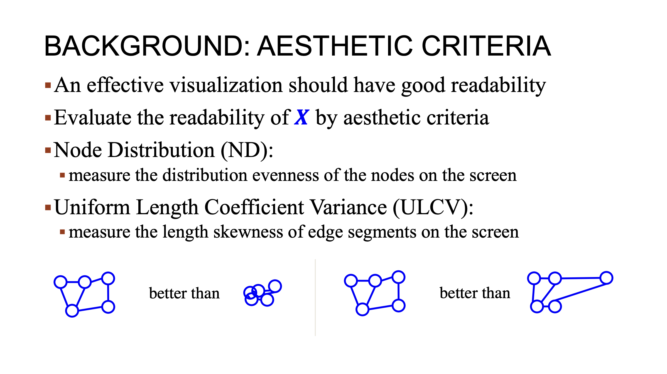
Notes:
A high quality graph visualization should have good readability. To evaluate the readability of visualization results, the graph drawing committee has proposed several aesthetic criteria, Node distribution and uniform length coeffiecient Variance are two commonly used criteria among them. Node Distribution measures the eveness of the distribution of the nodes on the screen. A good visualization should has those evenly spaced out, as shown on the left hand side. On the other hand, an example of poor, no distribution like the right hand side, would has overlapping nodes. For ULCV, it measures the length skewness of edge segments on the screen. An example of poor ULCV like the right hand side, would has distorted edge of variance making it harder to distinguish between relationships in the graph.

Slide 5
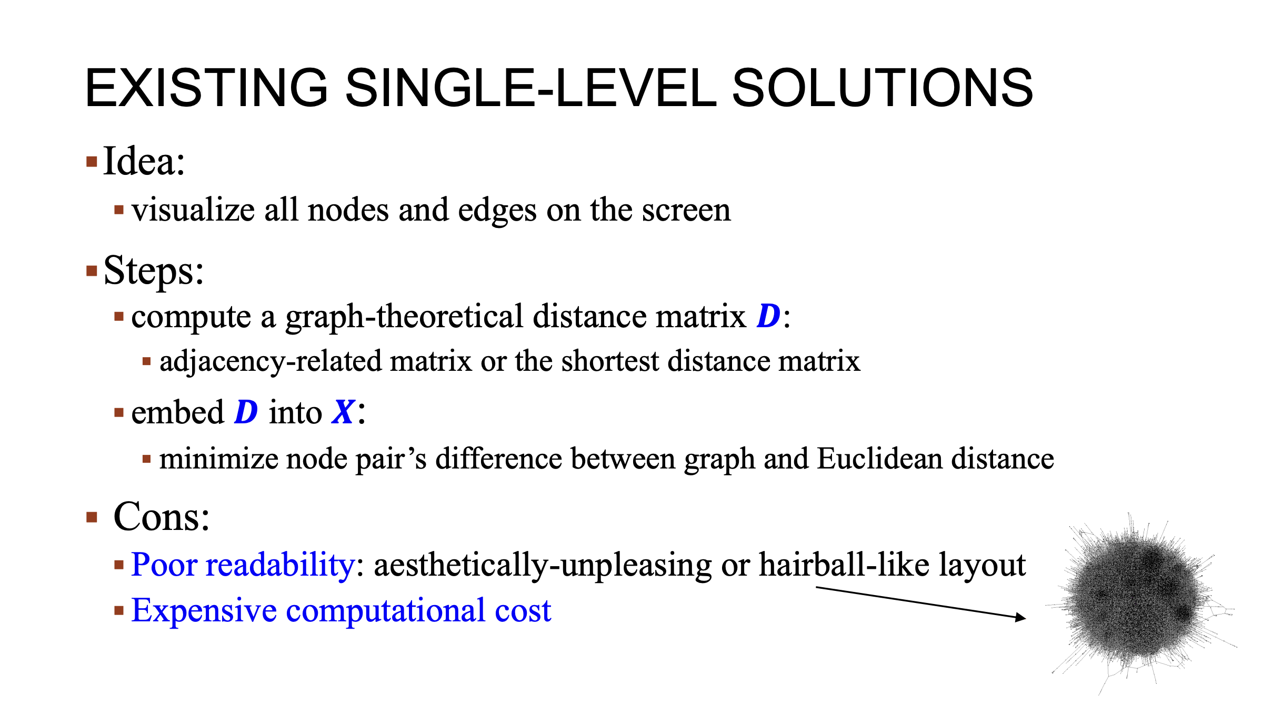
Notes:
Regarding existing visualization solutions. A common way is to show all nodes and edges on the screen, which is called single-level visualization. It generally involves two steps. First, a graph-theoretical distance Matrix is computed. These matrix can be obtained use eaiser adjacency-related matrix or the shortest distance matrix. Next, the distance matrix is embedded into the position matrix, aiming to minimize the difference between the pair west distance on the graph and Euclidean distance on this way. However, one drawback of this approach is the poor readability of the resulting visualizations, which are often aesthetic-unpleasing when the graph is small, or resemble hairball when the graph is large, making it challenging to interpret the graph’s structure. Additionally, this meathod can be computational expensive, which put these challenges when dealing with large graphs.

Slide 6
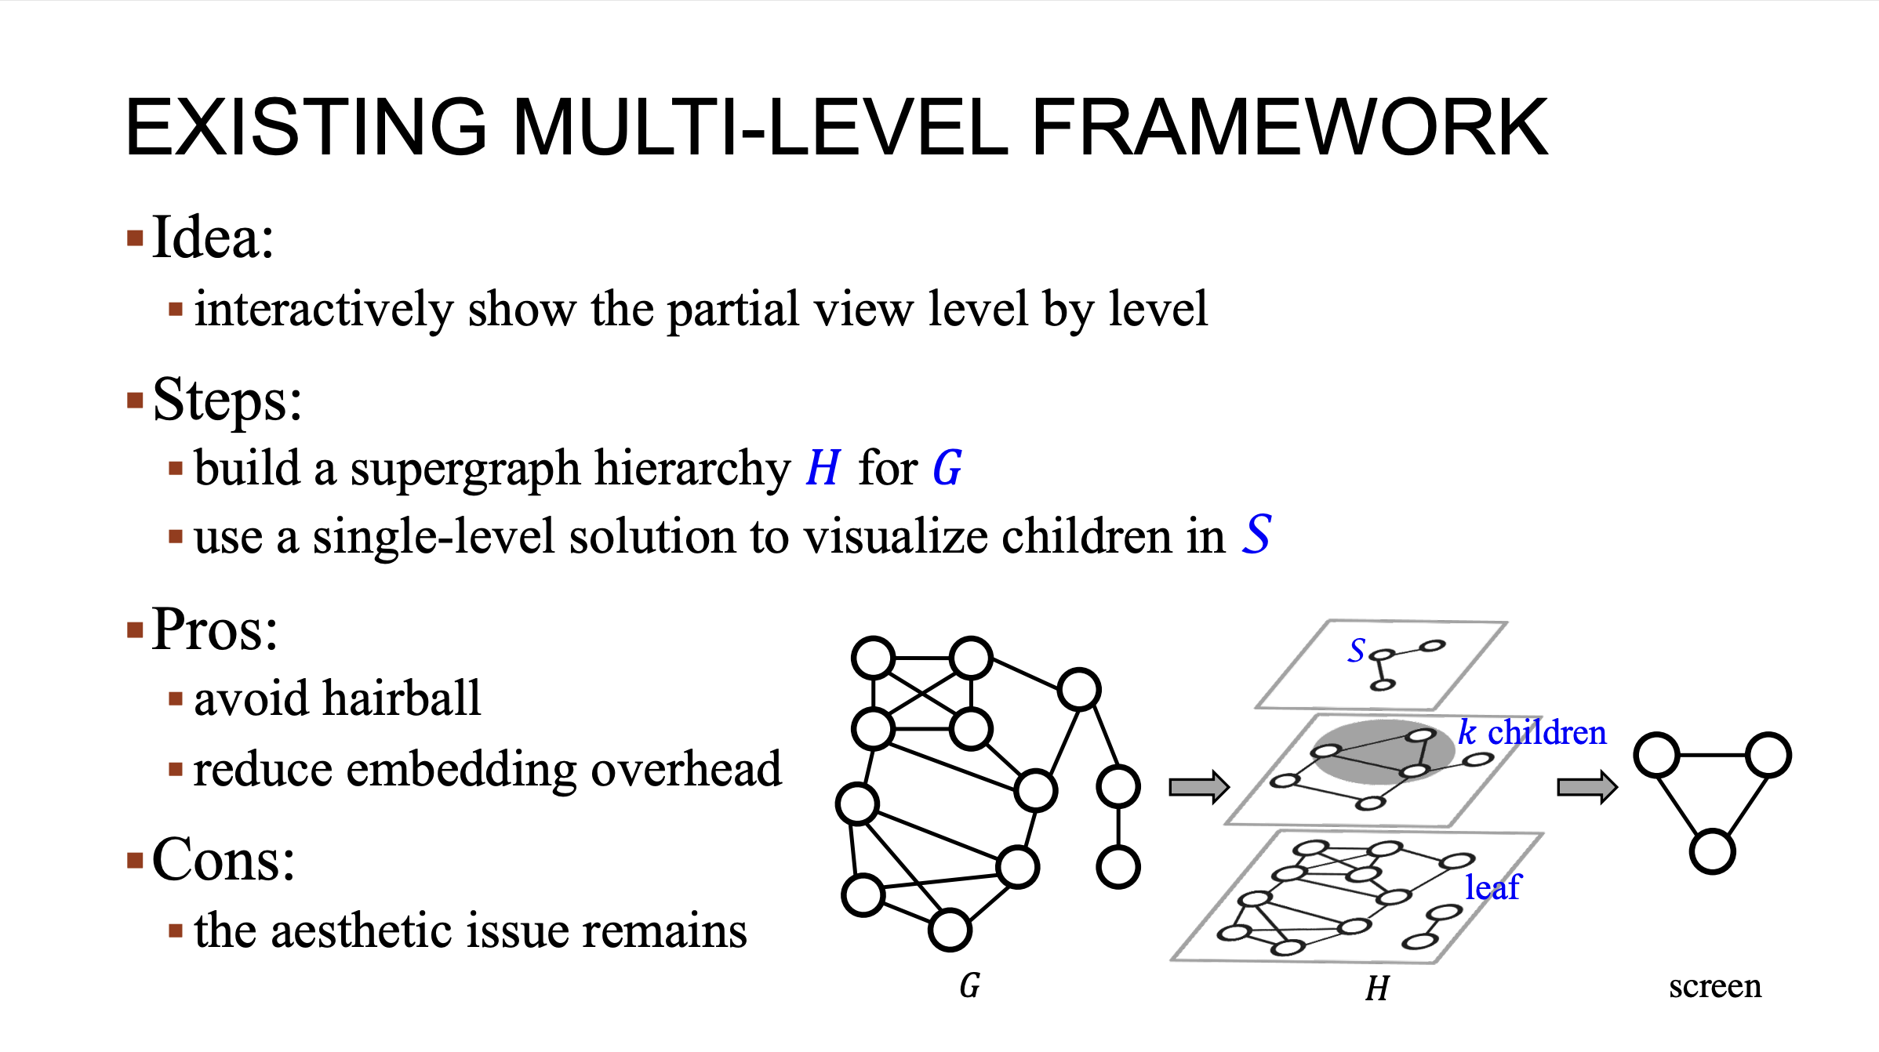
Notes:
To address the issues in single-level visualization. Many existing solutions adopt a multi-level framework whose idea is to interactively display the graph impartial view level by level. First, a supergraph hierarchy is constructed from the original graph G, as shown in this example, the bottom level is the input graph G, and we call the node in G as a leaf. We call the upper level a super graph and the node inside a super node. For example, the super node S in the Top level super graph. In addition, each super node contains K children in the level below. For example, the children of S are in the shadow area. After a user selects an S to explore, a single-level solution is applied to visualize the children of it. Compared with visualizing the entire graph at once, presenting the graph in a hierarchical manner can help to avoid a hairball effect and reduce the embedding overhead. However, the aesthetic issues still remains because the multilevel-solution also leverages the single level they all method.

Slide 7
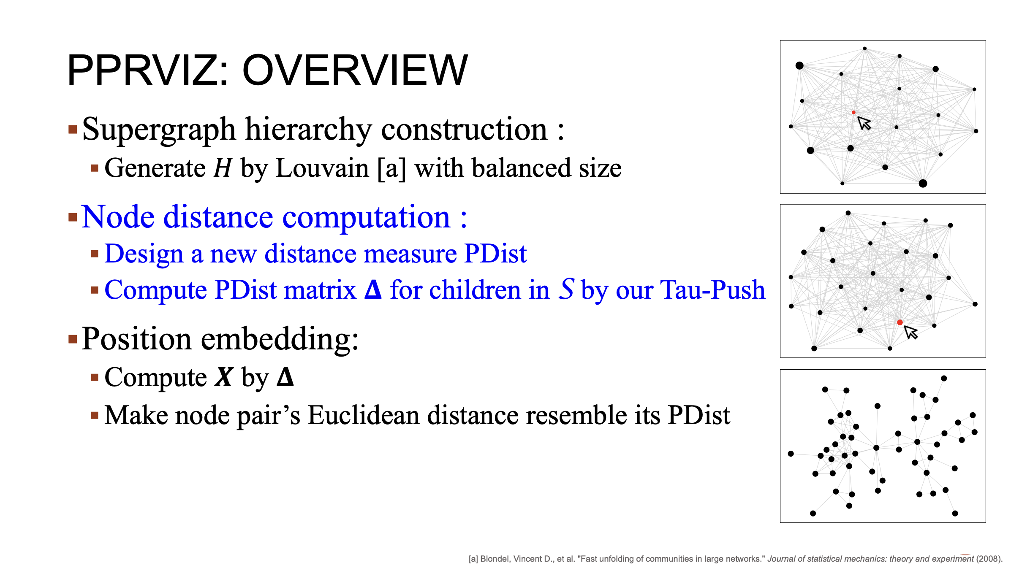
Notes:
To mitigate the issues raised by these exsisting solutions. We propose a graph visualization solution called PPRviz. It adopts the multi-level framework and contains the following three main steps. The first step is the construction of a super graph hierarchy. It is generated using the famous community detection algorithm Lovin, while trying to ensure that the number of children of each super node is balence. Next, PPRviz is introduces a new distance measure called PDist for computing graph-theoretical distance. These measures specifically designed for visualization captures the relationships between those in the more accurate manner. To compute the PDist for the children. the author then propose an efficient estimation algotithem called Tau-push. After PDist are computed, PPRviz proceed to perform position embedding, which calculates a position matrix based on the PDIst matrix. The score is to ensure that the Euclidean distance between pairs of node on the screen resemble their corresponding PDist. Here is a visualization instance generated by PPRviz. Here, the circle size is proportional to the number of children inside a super node. As we can see, PPRviz ways can clearly show the partial view of each level.

Slide 8
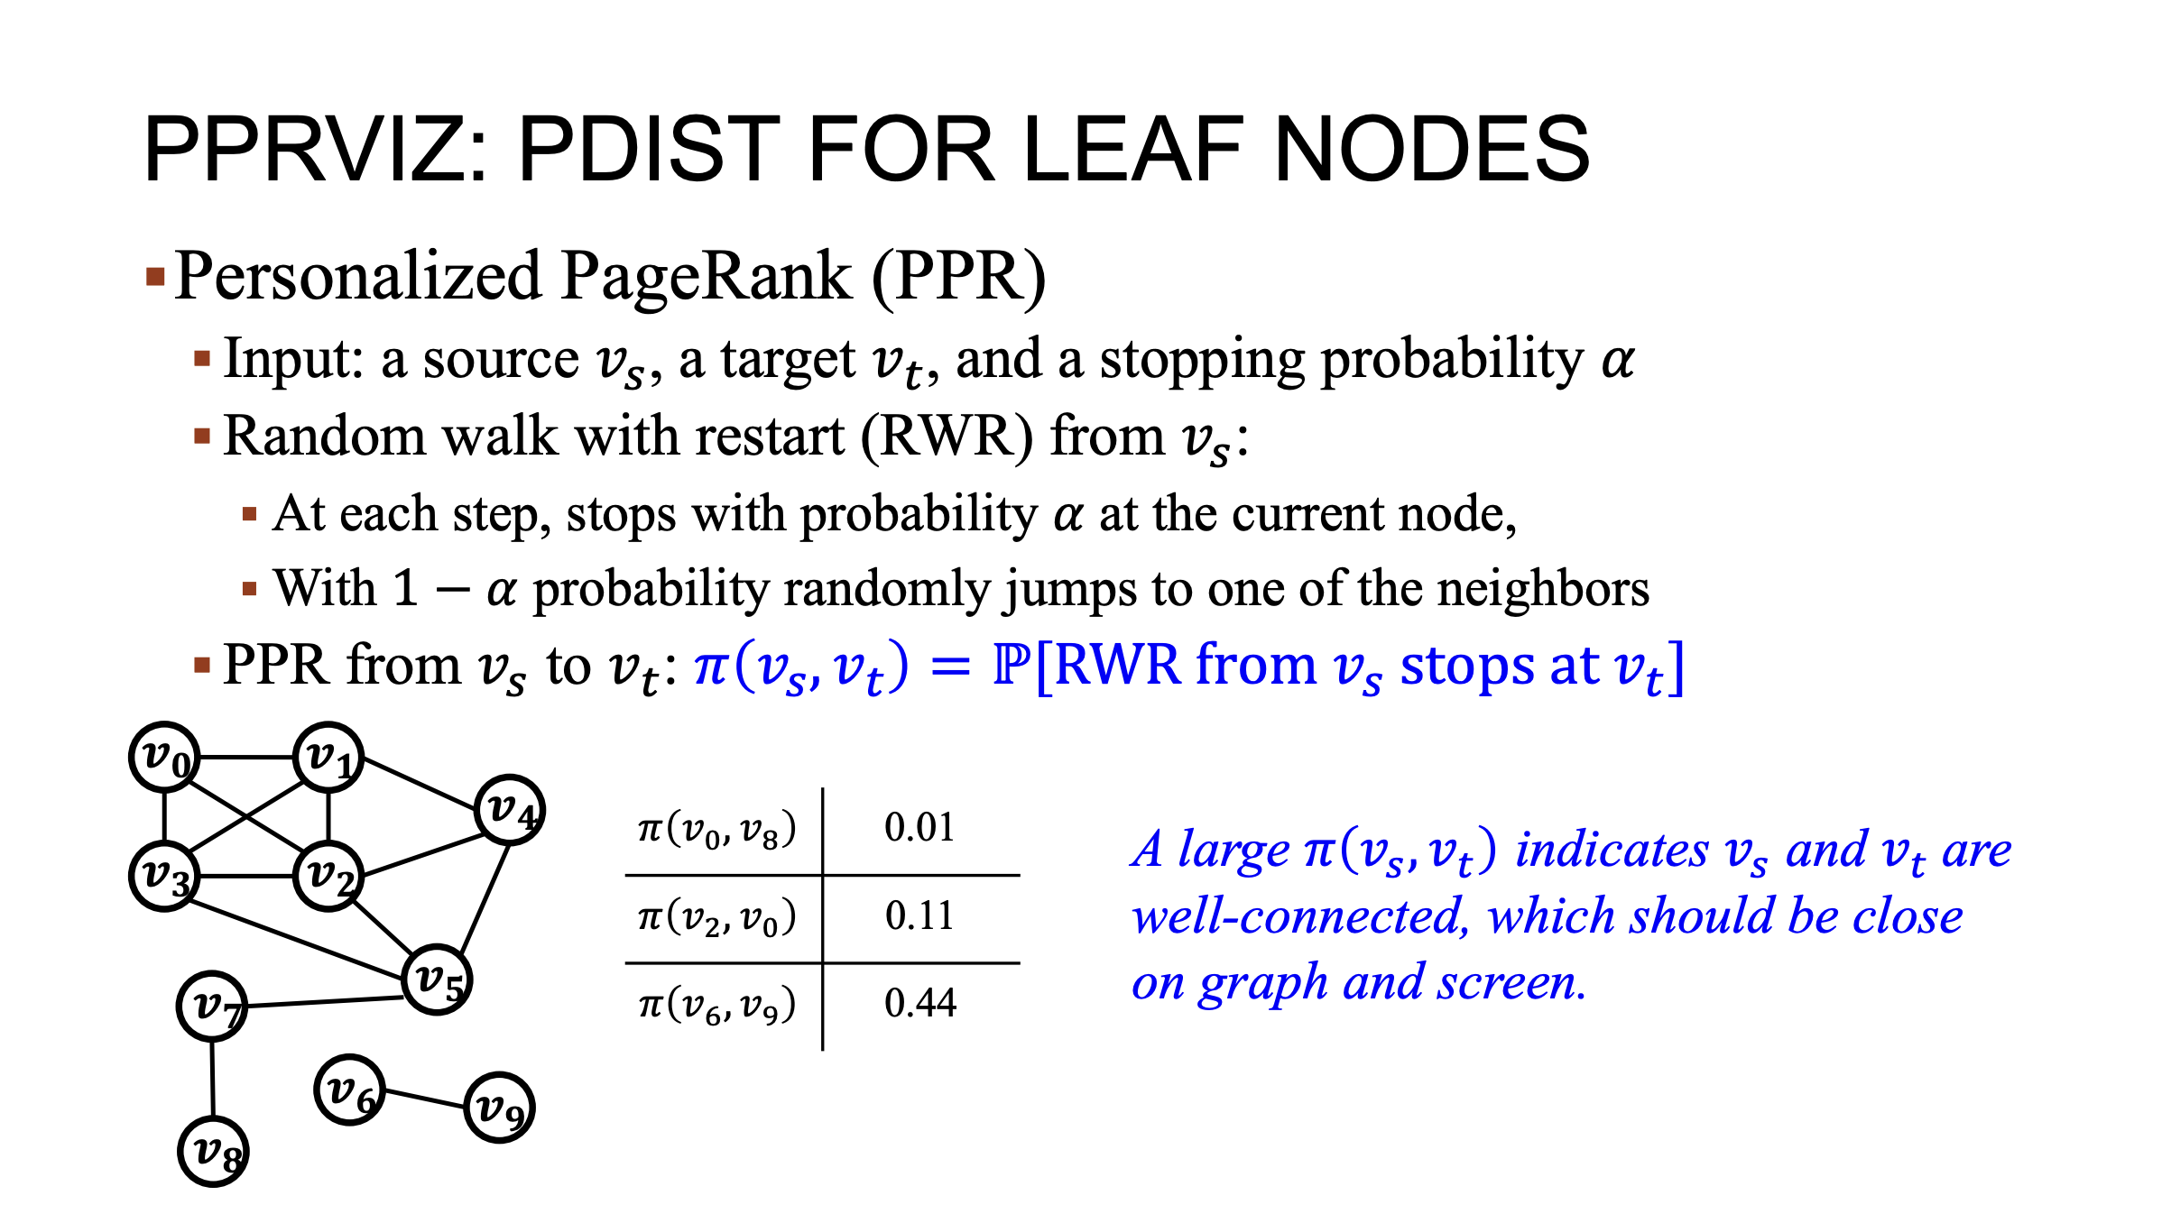
Notes:
Before PDist, I will first introduce personalized page rank for measure the connectivity between two nodes in the graph, which is the core of PDist. Given a source node Vs, a target node Vt and a stopping probability 阿尔法. PPR from vs to vt measures the probability that the random walk with restart from Vs stops and target node Vt. Take this graph as an example. The node pair, V6 and V9 are more connected to each other than node pair V0 and V8. Accordingly PPR from V6 to V9 is larger than that from V0 to V8. In other words, a large PPR value reflects that the node pair are well-connected on the graph, and should be close on the graph when viusalize on the screen.

Slide 9
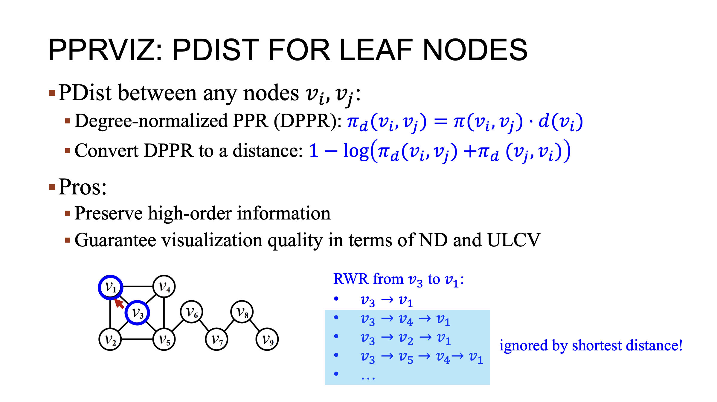
Notes:
In PDist, elaborate the concept of degree-normalized PPR. The DPPR between any nodes Vi and Vj is defined as a ----- of the personalized page rank and the degree of the source node. This degree normalization ensures a better viusalization quality. To convert the DPPR to PDist, They use a formula of 1 minus logarithm. This transformation helps us represent the DPPR values in a decent like format in enabling the subsequent position embedding step, using DPPR as this matrix offer several advantages. First, it preserves the higher order information captured by RWR, allowing us to determine node coordinates based on a more accurate graph theoretical distance, for example, to measure the graph distance from V3 to V1, RWR considers the path as follows. In contrast, the shortest distance only considers the first one. Second, PDist guarantees the quality of visualization in terms of ND and ULCV. These two advances mean that the resulting visualizations reflect the topology information, well providing a clear representation.

Slide 10
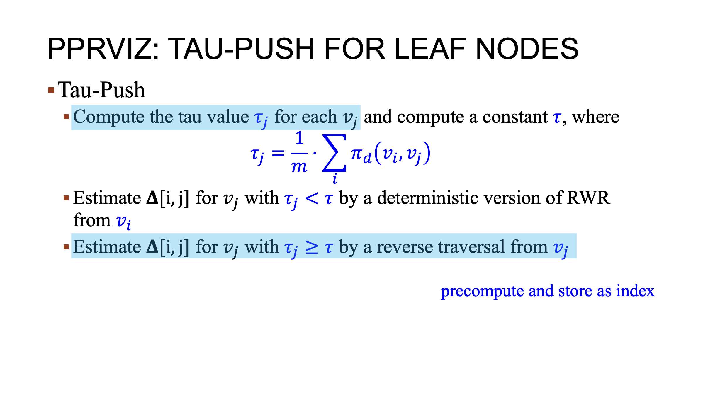
Notes:
Now, I will introduce the main steps of the proposed Tau-push algorithm, Tau-push first computes the tau value for each node Vj, which is the average of DPPR value from all nodes to Vj. Then Tau-push computes critical constant [Tao], which helps to trade off the computational overhead of the next two steps. After that, a deterministic version of rwr is involved from each children Vi to estimate PDist for other small [Tau] children. At last, a reverse graph traversal is conducted from the large [Tau] children, Vj to estimate PDist for all other children. Furthermore, the first step and the third step are precomputed and stored at the index

Slide 11
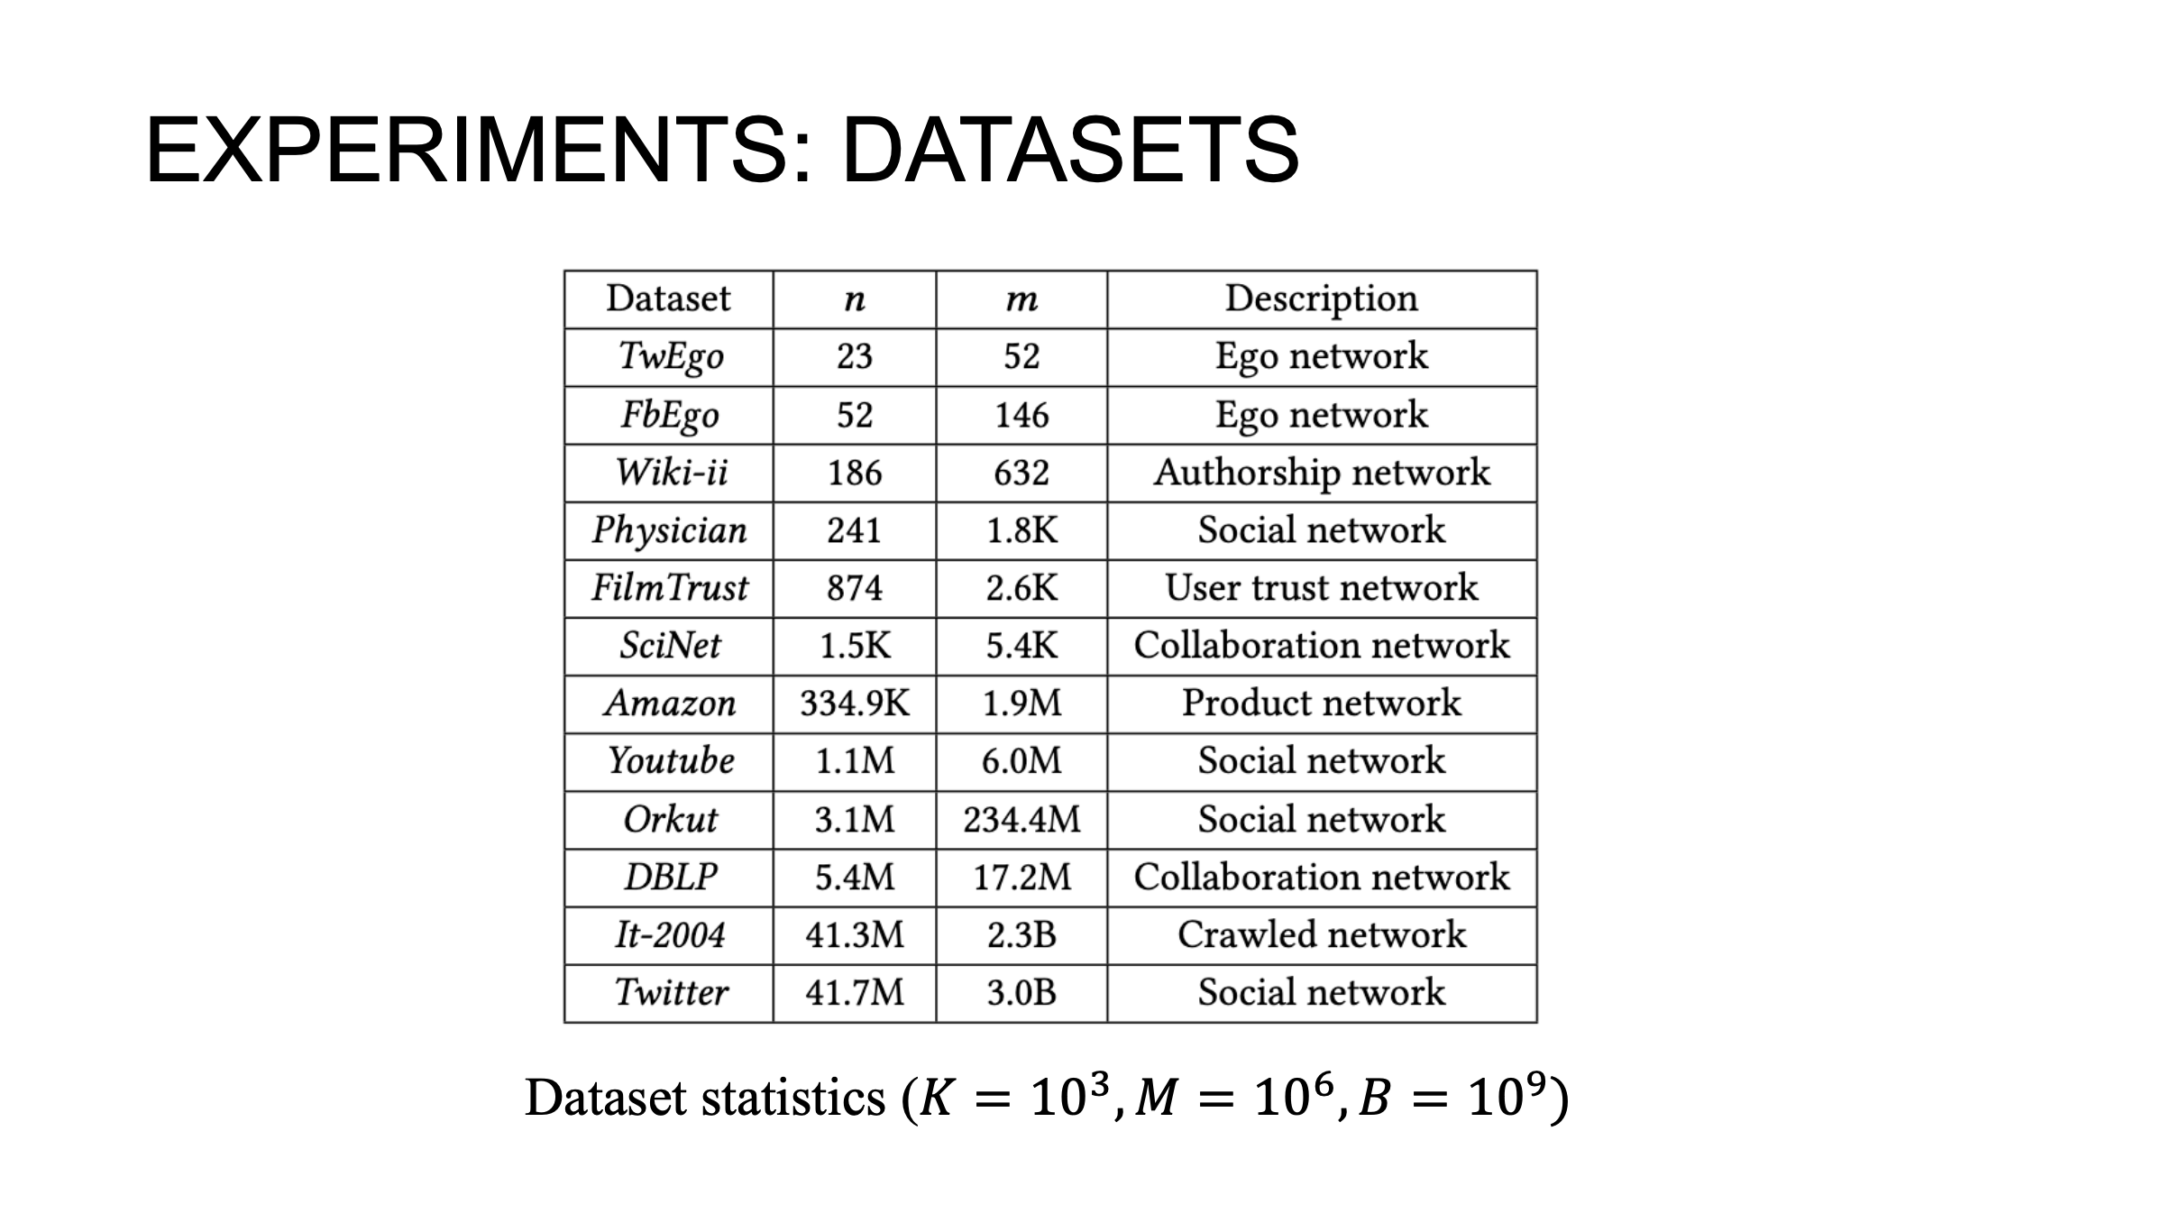
Notes:
To evaluate the performance on proposed PPRviz, They conduct experiments on 12 real world graphs from different fields in which the largest graph Twitter contains three billion edges.

Slide 12
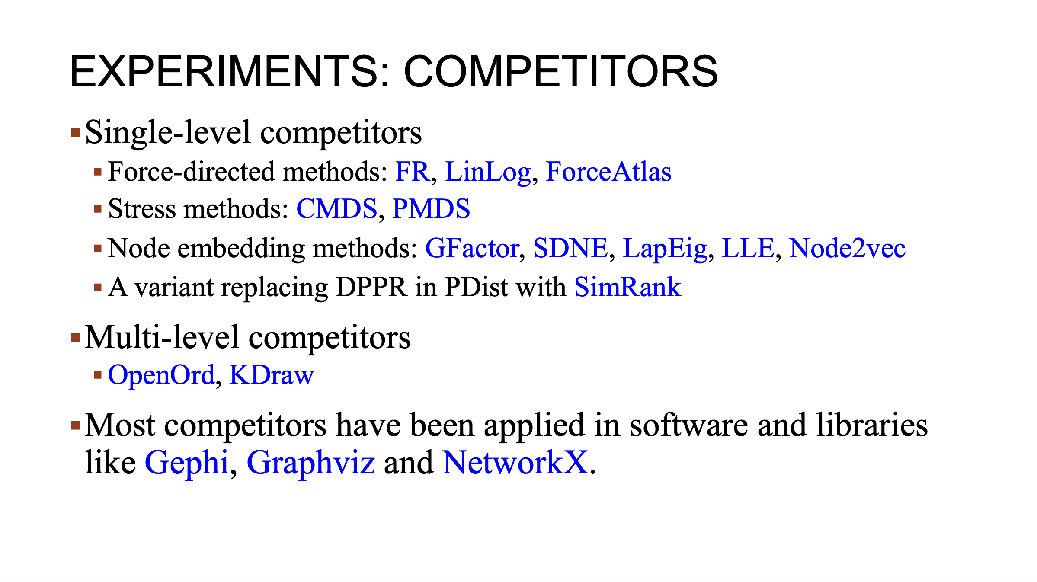
Notes:
They compare PPRviz with the following visualization solutions from different categories. It is worth noting that most competitors have been applied in software and libraries like Gephi, Graphviz and NetworkX.

Slide 13
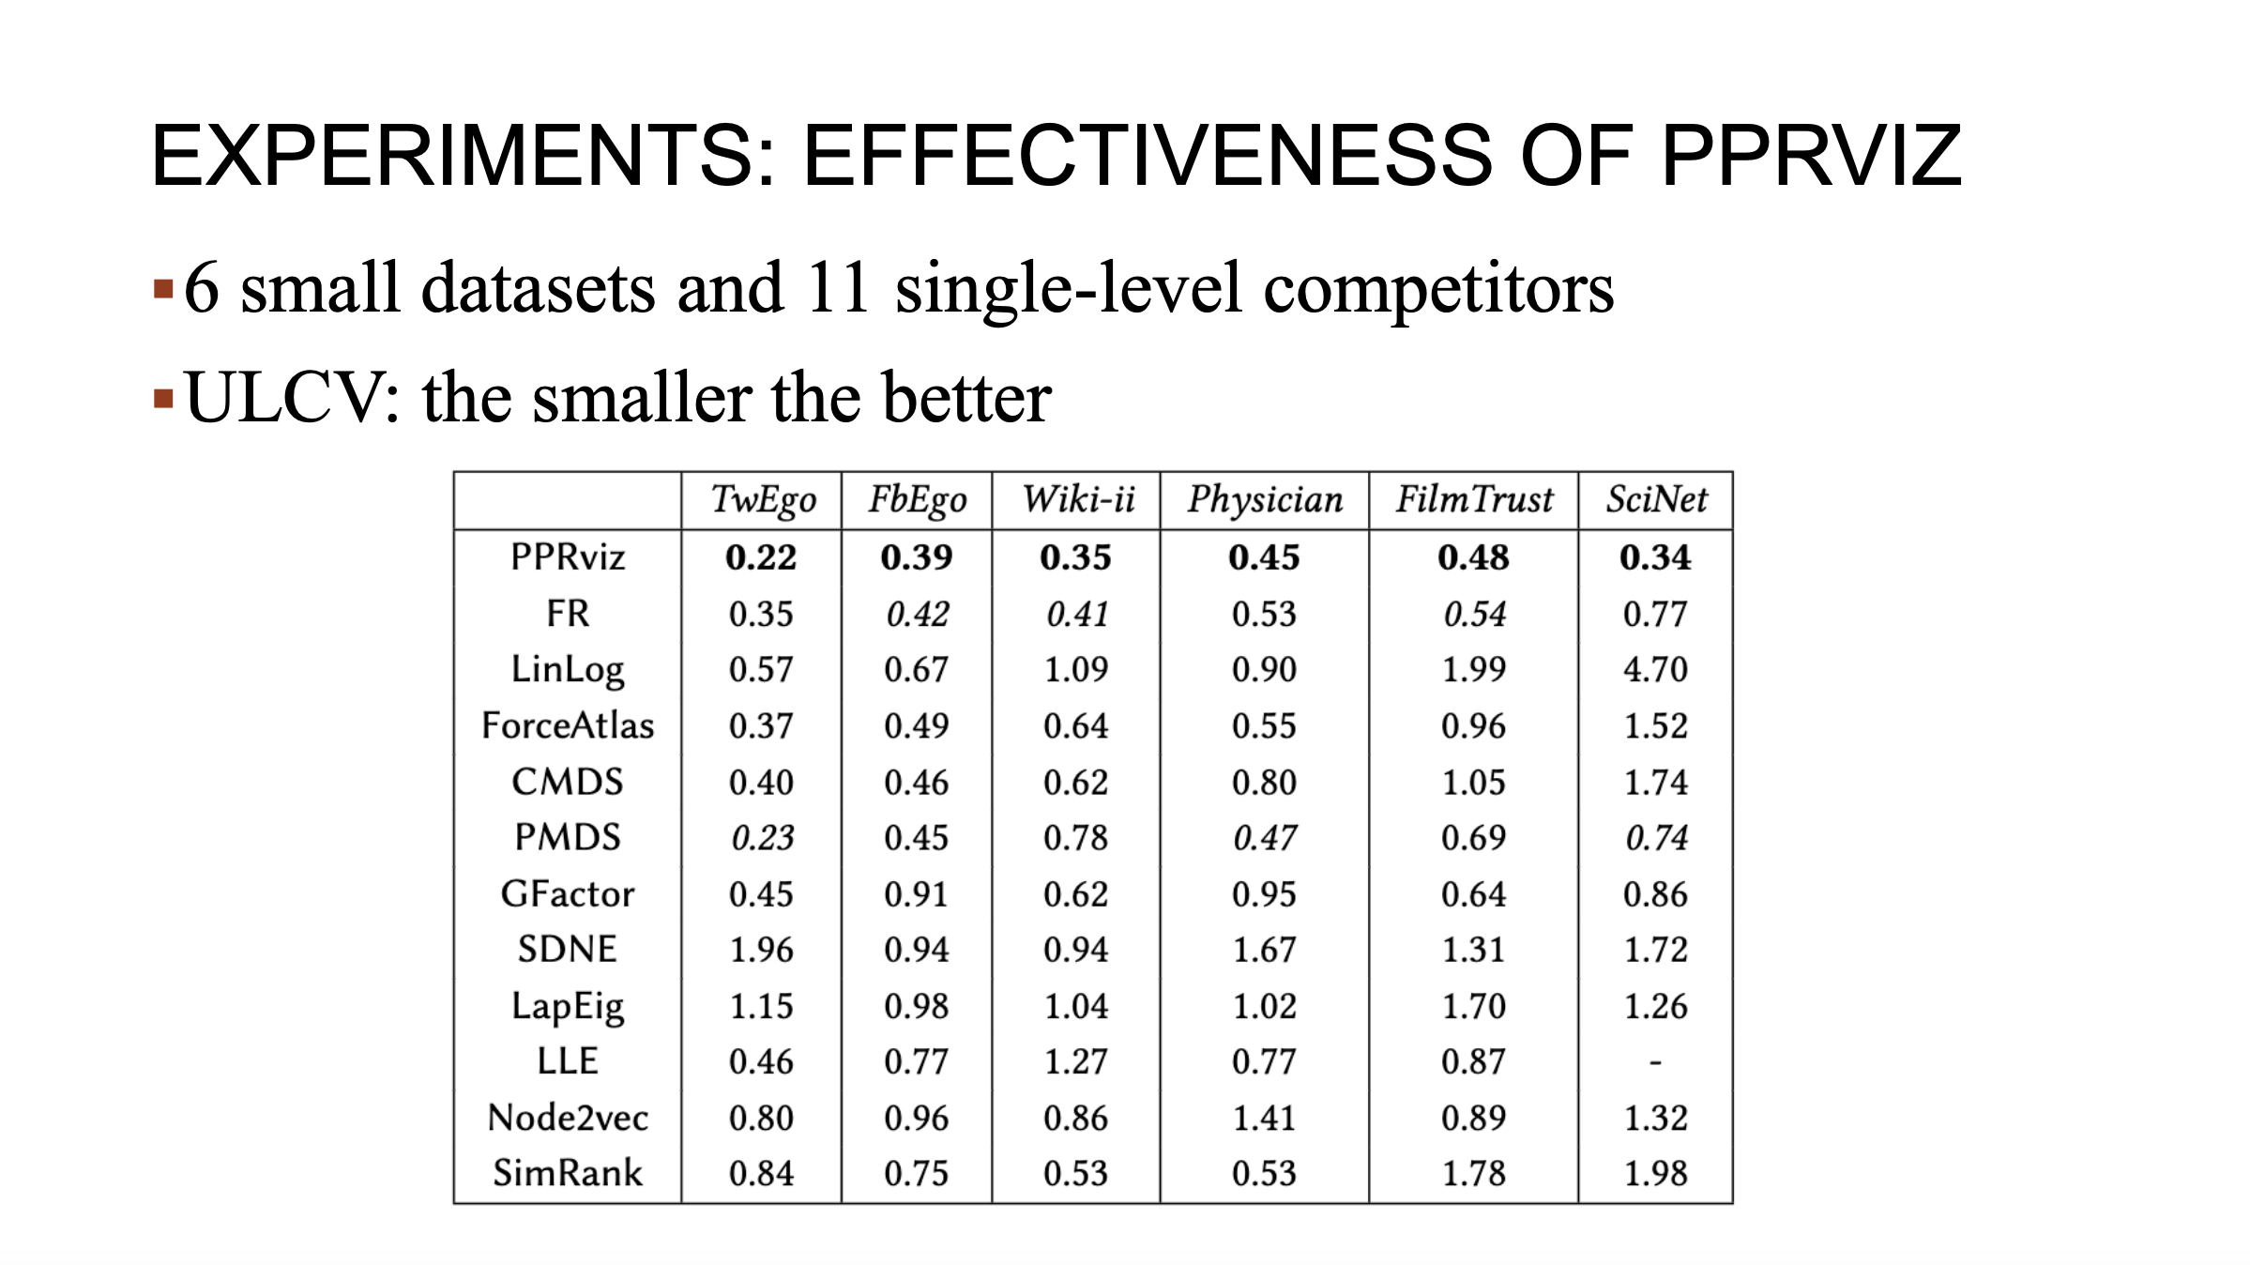
Notes:
To evaluate the effectiveness of PPRvis, they compare PPRviz and 11 single-level competitors on six small data sets in terms of aesthetic criteria. As reported in the table, we can find that PPRviz can outperform all competitors in terms of ULCV.

Slide 14
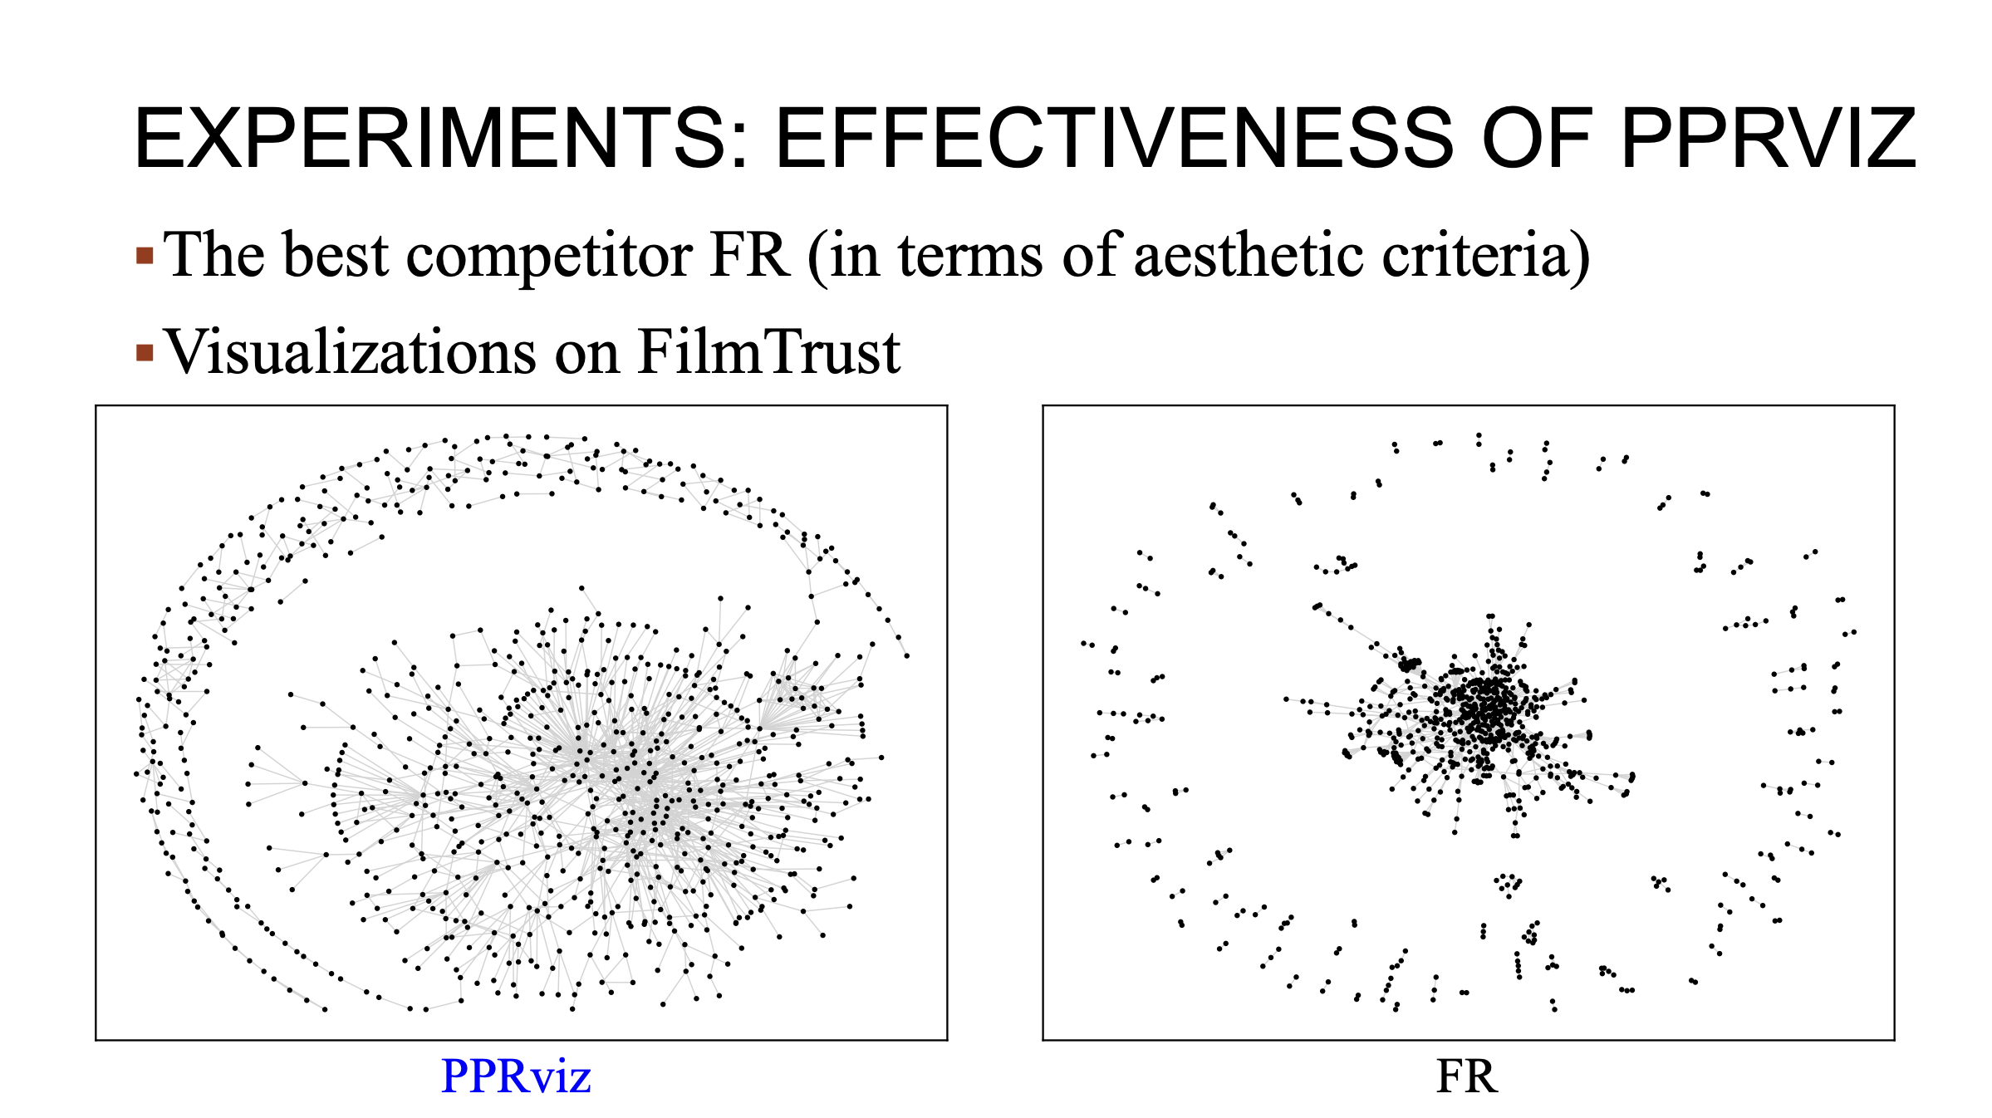
Notes:
Here, show the visualization results of PPRviz and the best competitor FR. In these two figure, we can find that PPRviz shows clearer relationships on film trust and has less overlapping compared with FR.

Slide 15
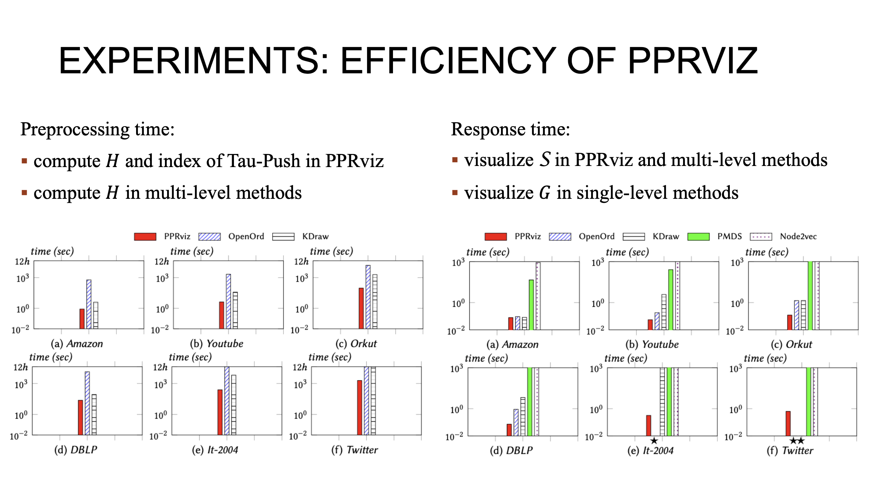
Notes:
To evaluate the efficiency of PPRviz, I first report the preprocessing time of PPRviz and multi-level competitors. As shown in the figure, we can find that the preprocessing time of PPRviz within 20 minutes, even on the largest graph Twitter. In contrast, all competitors fail to return within 12 hours. They next report the response time of PPRviz and all competitors. They skipped the single-level competitors that fail to return in 1,000 seconds. As shown in this figure, we can find that PPRviz outperforms all competitors in terms of response time, it only uses several seconds to return the partial view for the largest Twitter graph.

Slide 16
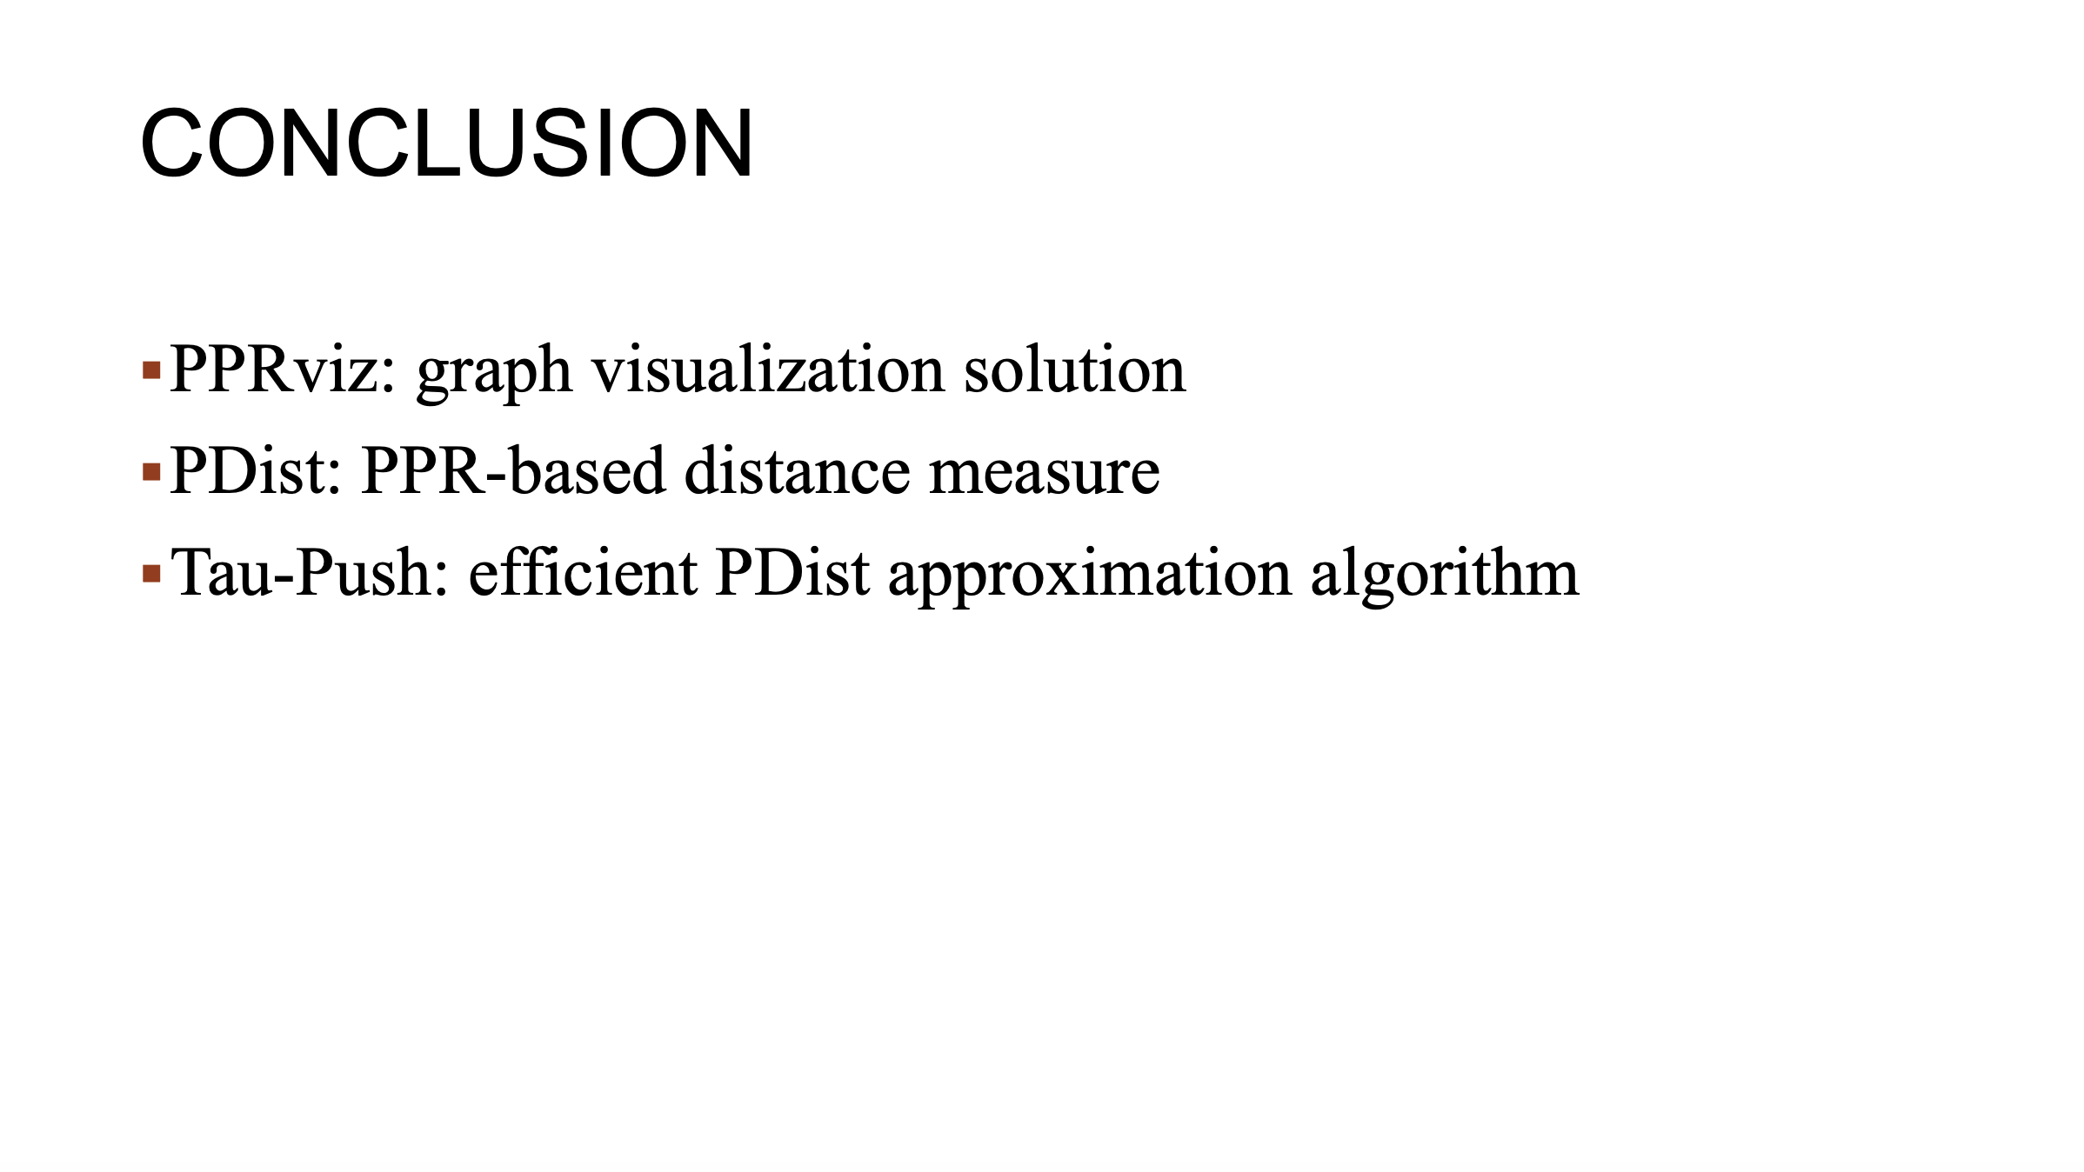
Notes:
To summarize, in this work, They propose a new graph visualization solution called PPRviz, which contains a PPR-based distance measure, and an efficient PDist approximation algorithm.

Slide 17

Notes:
That’s all. Thanks for your listening.

